Slide 1
Met Office Climate Data Challenge – PML input
Tim Smyth, Andy Rees, Helen Findlay, Vas Kitidis

Slide 2
The Challenge
People’s experience of climate and environmental change is bound in time and space i.e. local over relatively short time periods.
Projections of climate and environmental change are global and over long time periods.
Observations, which are critical for forming our understanding, prediction and verification of climate and environmental change are bound in time and / or space.
Question: How can we use data to visualise and bridge this gap?

Slide 3
Marine data sources – (p)CO₂ and pH
Decadal time-series in the western English Channel (westernchannelobservatory.org.uk)
Subject to seasonal and interannual variability (csv)
Process driven series of research expeditions in the Celtic Sea (2015)
Subject to seasonal variability (csv)
Atlantic Basin Transects over a 20+ year time frame (www.amt-uk.org)
Subject to spatial, seasonal and interannual variability (csv)
Global Reconstructions of pCO₂
Individual cruises composited to form a global picture (netCDF)

Slide 4
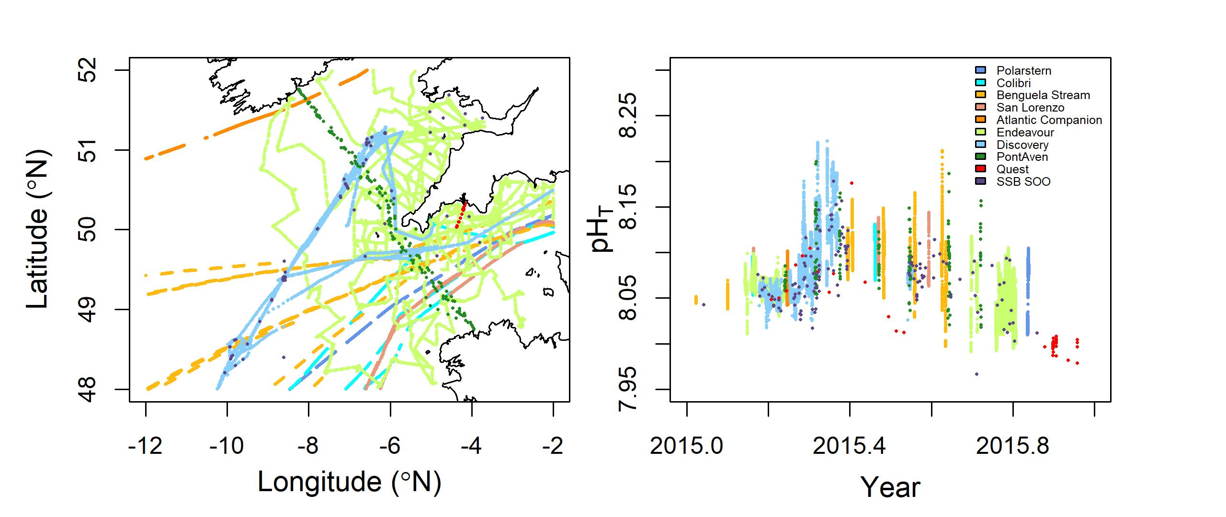
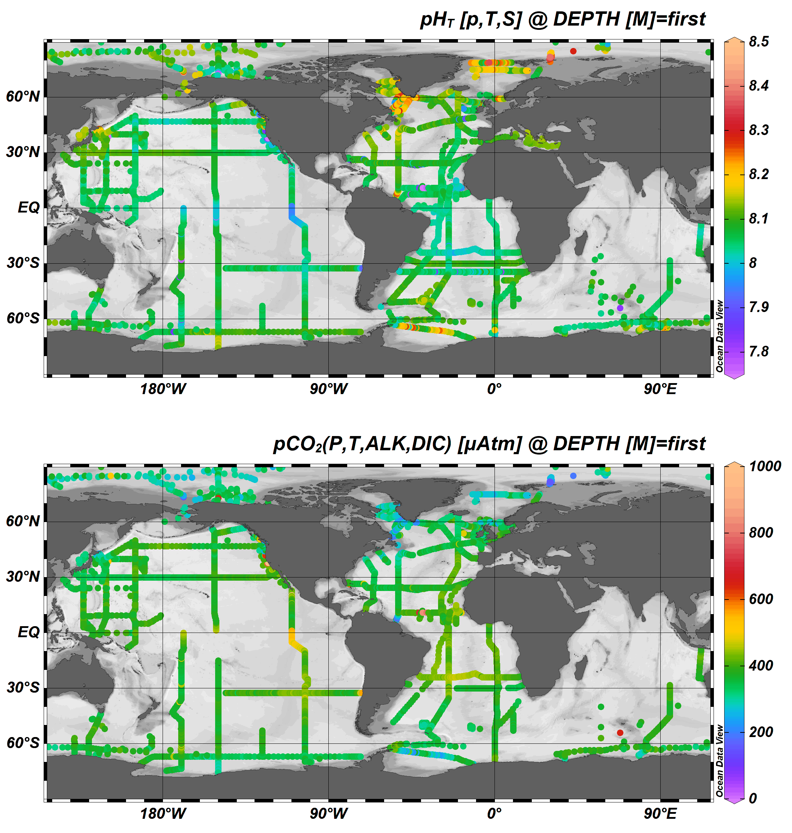
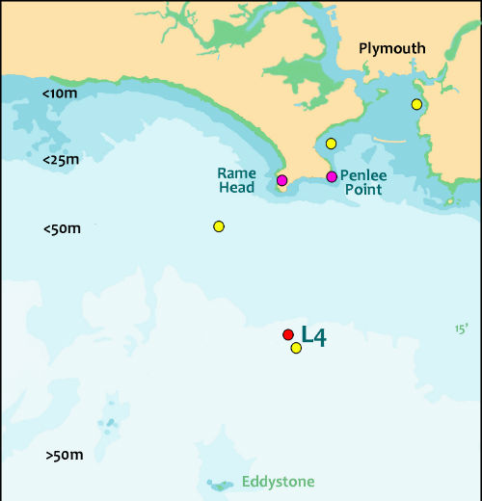
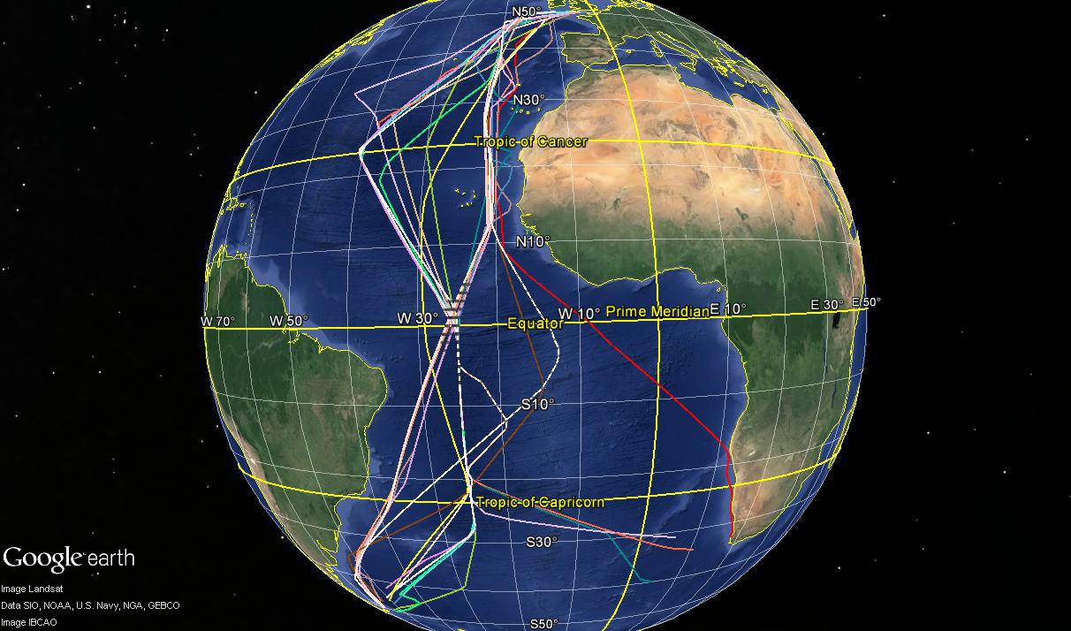
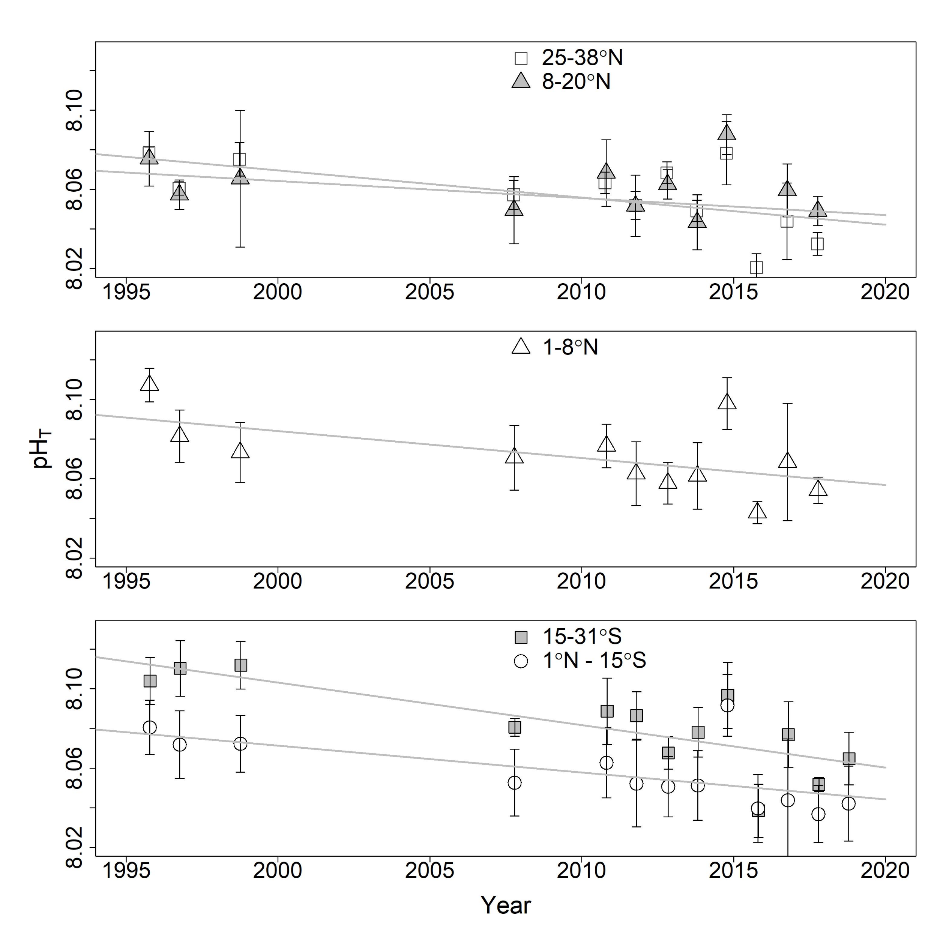
Challenge – fit these different scales together to form narrative

